Slide 1
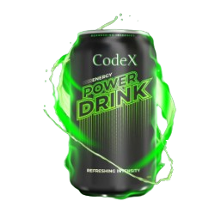
MARKETING INSIGHTS OF CODEX

Slide 2
CONTENT
01 ABOUT CODEX
02 PROBLEM STATEMENT
03 PRELIMINARY INSIGHTS
04 SECONDARY INSIGHTS
05 RECOMMENDATIONS

Slide 3

ABOUT CODEX
CodeX is a German beverage company that is aiming to make its mark in the Indian market. A few months ago, they launched their energy drink in 10 cities in India.
Their Marketing team is responsible for increasing brand awareness, market share, and product development. They surveyed those 10 cities and received results from 10k respondents.

Slide 4



PROBLEM STATEMENT
Problem 1
Problem 2
Problem 3
How to increase Brand Awareness?
How to increase Market Share?
How to go about the Product Development?

Slide 5
INSIGHTS TO EXTRACT
Primary Insights
Demographic Insights
Consumer Preferences
Competition Analysis
Marketing Channels and Brand Awareness
Brand Penetration
Purchase Behavior
Product Development

Slide 6
Secondary Insights
What immediate improvements can we bring to the product?
What should be the ideal price of our product?
What kind of marketing campaigns, offers, and discounts we can run?
Who can be a brand ambassador, and why?
Who should be our target audience, and why?

Slide 7




DEMOGRAPHIC INSIGHTS
Who prefers energy drink more? (male/female/non-binary?)
Which age group prefers energy drinks more?
Which type of marketing reaches the most Youth (15-30)?

Slide 8
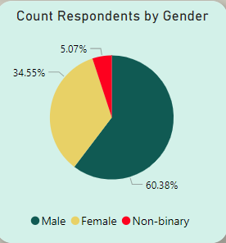
Who prefers energy drink more(male/female/non-binary) ?
Out of 10 thousand respondents, the number of male respondents is 6038.
This shows 60% of the consumers are male who prefer energy drinks more.

Slide 9
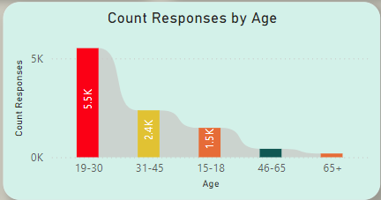
Which age group prefers energy drinks more?
From the result of this survey, we get to know that energy drinks are more popular among youngsters. More than 50% of the respondents belong to the Age Group 19-30.
If we look at overall young age groups from 15 to 30, then the % will rise to 70%

Slide 10
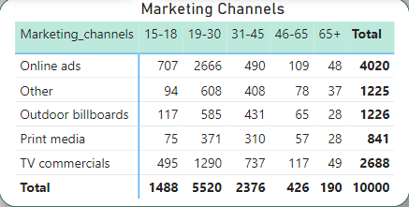
Which type of marketing reaches the most Youth (15-30)?
Online Ads are the most effective channel that reached 3373 respondents Age group 15-30.

Slide 11





CONSUMER PREFERENCE
What are the preferred ingredients of energy drinks among respondents?
What packaging preferences do respondents have for energy drinks?

Slide 12
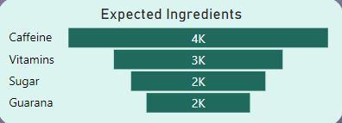
What are the preferred ingredients of energy drinks among respondents?
As we know caffeine increases attention and alertness, and it is often used in energy drinks. Caffeine is the most expected ingredient with 4K respondents followed by the Vitamins in energy drinks.

Slide 13
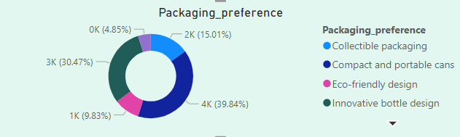
What packaging preferences do respondents have for energy drinks?
Around 40% of the respondents prefer Compact & Portable Cans followed by Innovative Bottle Designs with 30.47% of respondents.

Slide 14




COMPETITION ANALYSIS
Who are the current market leaders?
What are the primary reasons consumers prefer those brands over CodeX?

Slide 15
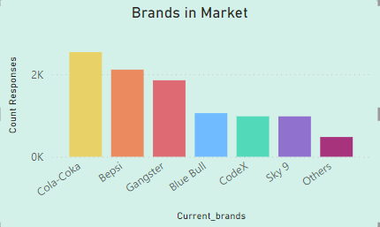
Who are the current market leaders?
Cola Coka is leading the market followed by Bepsi. The data shows there more respondents for Cola Coka than the other brands.

Slide 16
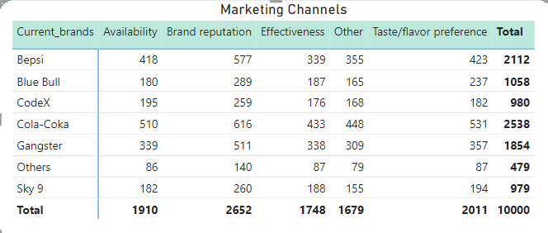
What are the primary reasons consumers prefer those brands over CodeX?
The top reason for choosing the brands by consumers is brand reputation.

Slide 17



MARKETING CHANNELS AND BRAND AWARENESS
Which marketing channel can be used to reach more customers?
How effective are different marketing strategies and channels in reaching our customers?

Slide 18
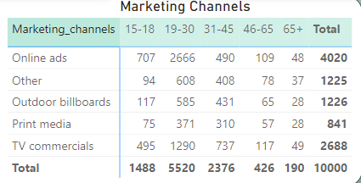
As we have seen previously Online Ads are the most effective way to reach maximum audiences in a short duration & it is cost effective as well.

Slide 19



BRAND PENETRATION
What do people think about our brand? (overall rating)
Which cities do we need to focus more on?

Slide 20
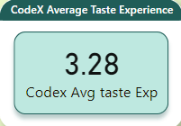
What do people think about our brand? (overall rating)
Out of 980, 455 people have heard about our brand and hence we consider their ratings for the CodeX product’s taste.
This rating of 3.28 is the industry average rating as well.

Slide 21
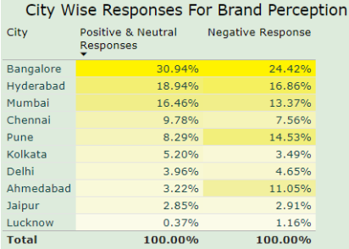
Which cities do we need to focus more on?
This Data shows people’s perception of CodeX as a brand in different cities.
The neutral and negative responses are combined in this visual as they both are great in numbers than the positive responses. Hence improving the Positive response is one area where the marketing should focus on.

Slide 22



PURCHASE BEHAVIOR
Where do respondents prefer to purchase energy drinks?
What are the typical consumption situations for energy drinks among respondents?
What factors influence respondents' purchase decisions, such as price range and limited edition packaging?

Slide 23
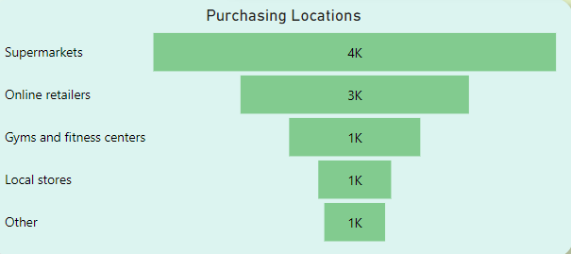
Where do respondents prefer to purchase energy drinks?
Supermarkets are the most common choice among consumers to buy energy drinks.

Slide 24
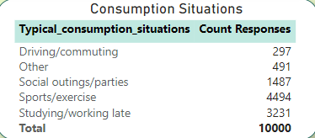
What are the typical consumption situations for energy drinks among respondents?
Sports/exercise ,Studying/working late are the most common consumption situation Also, this data shows youth is consuming these drinks more.

Slide 25
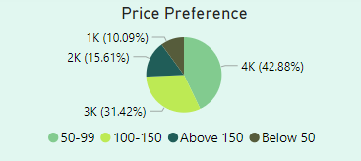
What factors influence respondents' purchase decisions, such as price range and limited edition packaging?
43% of the consumers buy a product if the price is between 50-99.

Slide 26
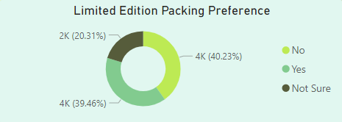
40% of the consumers do not expect a change in the packaging while 39% of consumers are open to trying the Limited Edition Packaging.

Slide 27



PRODUCT DEVELOPMENT
Which area of business should we focus more on our product development? (Branding/taste/availability)

Slide 28
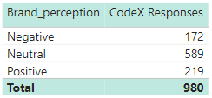
Out of 980 respondents of CodeX, only 219 have a positive brand perception.
The taste experience rating is the same as the industry rating. This is not something that needs immediate attention.

Slide 29
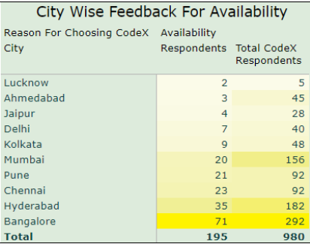
We need to work on the availability of the product. About 20% of the consumers choose the product because it is available. Availability is a major factor in sales of a product.

Slide 30
RECOMMENDATIONS FOR CODEX
What immediate improvements can we bring to the product?
What should be the ideal price of our product?
What kind of marketing campaigns, offers, and discounts we can run?
Who should be our target audience, and why?

Slide 31
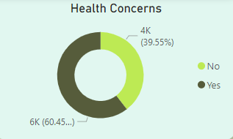
What immediate improvements can we bring to the product?
Availability
Health Concern – If possible another survey related to health concern questions. (455 Respondents who have heard about us)
Limited Edition Packaging
Add more natural ingredients, reduce sugar content and add more flavors.
Improve positive response rate

Slide 32
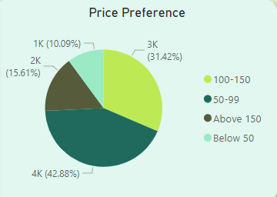
What should be the ideal price of our product?
The price range expected by consumers lies between 50 to 150.
In cities like Ahmedabad, Chennai, Hyderabad, Kolkata, Lucknow, Mumbai, and Pune consumers expect the price range to be between 50 to 99.
While in the rest of the cities, people are willing to pay up to 150.

Slide 33
What kind of offers and discounts we can run?
In the previous recommendation, we saw that we can experiment with the price in different cities. Also, if changing the price does not go with the brand’s strategy, we can provide offers on buying the pack of 6 cans at a cheaper cost.
Also, each of these cities celebrates multiple festivals throughout the year. We can come up with the gift set packs.

Slide 34
What kind of marketing campaigns we can run?
Social Media
Influencer Marketing
Online Retailers/E-commerce
Guerilla Marketing

Slide 35
Social Media
We have seen in the insights that our consumers fall in the age group of 15 to 30. This age group is very much active on social media. Also, they get to know about the products from online ads. Running Social Media Ads can be a good strategy to reach them.
Influencer Marketing
Cheap – Influencer marketing can be very cheap we set a strategy to target influencers and their audiences. We can work on a barter system or by paying some amount to the influencers.
Collaborating with local influencers (multiple Macro & Micro) – We can collaborate with the influencers with the following of 10k to 100k, then 100k to 500k and so on. This will help our brand with branding and sales.

Slide 36
Online Retailers/E-commerce
E-commerce and online grocery store do have their own PPC platforms. We can run paid ads on these platforms to increase the sale of the product because we are still not as well known by the consumers as the other brands.
Guerilla Marketing
Consumers are buying products from supermarkets – We need to do some kind of special displays in supermarkets like renting and setting up a counter, or paying supermarkets for a space to display our products exclusively.
Participate in Events – Like in Delhi The Grub Fest, Horn-oK-Please and similar food festival events. We can do some creative campaigns here to attract consumers and provide free testers to get more feedback on tasting to get reasonable insights.

Slide 37
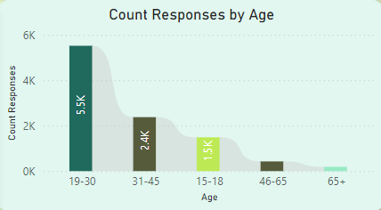
Who should be our target audience, and why?
It is evident from the statistics that our consumers are mostly between the ages of 15 to 30.
From this survey, the count shows that 70% of consumers are youth.

Slide 38
Thank you
BARKHA JAIDEO TANDEKAR
4TH YEAR (BTECH)

